Slide 1

CASE STUDY REDDIT

Slide 2
THE INSOMNIACS
ABHIJIT MISHRA
G. SAI PRASASTH KOUNDINYA

Slide 3
INTRODUCTION
Reddit is an American social news aggregation, web content rating, and discussion website.
Registered members submit content to the site such as links, text posts, and images, which are then voted up or down by other members.
Posts are organized by subject into user-created boards called "subreddits", which cover a variety of topics including news, science, movies, video games, music, books, fitness, food, and image-sharing.
Submissions with more up-votes appear towards the top of their subreddit and, if they receive enough up-votes, ultimately on the site's front page.

Slide 4
HISTORY
The idea and initial development of Reddit originated with then college roommates Steve Huffman and Alexis Ohanian in 2005.
Their initial idea, My Mobile Menu, was unsuccessful, and was intended to allow users to order food by SMS text messaging. During a brainstorming session to pitch another start up, the idea was created for what they called the "front page of the Internet".
Reddit's logo consists of a time-traveling alien named Snoo. Ohanian doodled the creature while bored in a marketing class.

Slide 5
GENERAL USAGE FLOWS
Browsing
Commenting
Upvoting
Following Subreddits
Posting

Slide 6
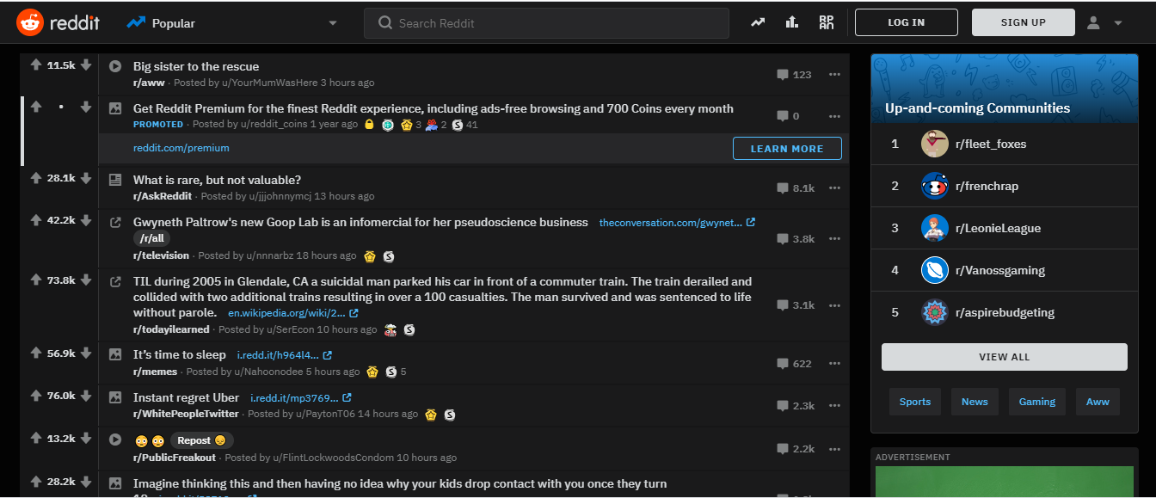
HOME PAGE

Slide 7
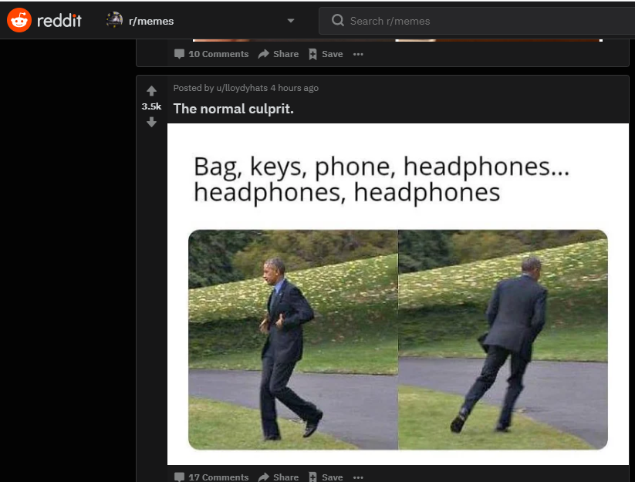
BROWSING

Slide 8
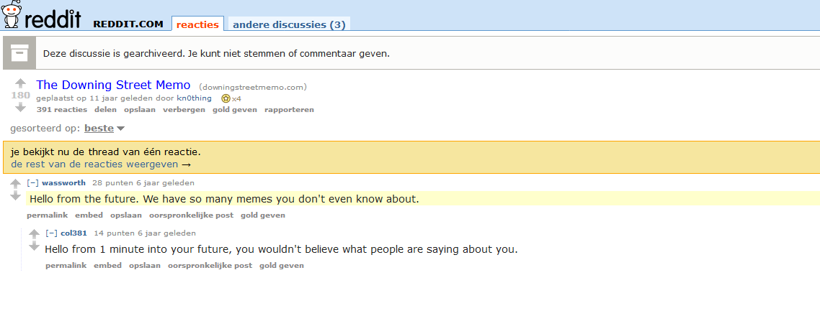
COMMENTING

Slide 9
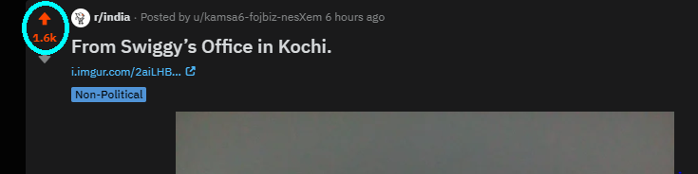
UPVOTING

Slide 10
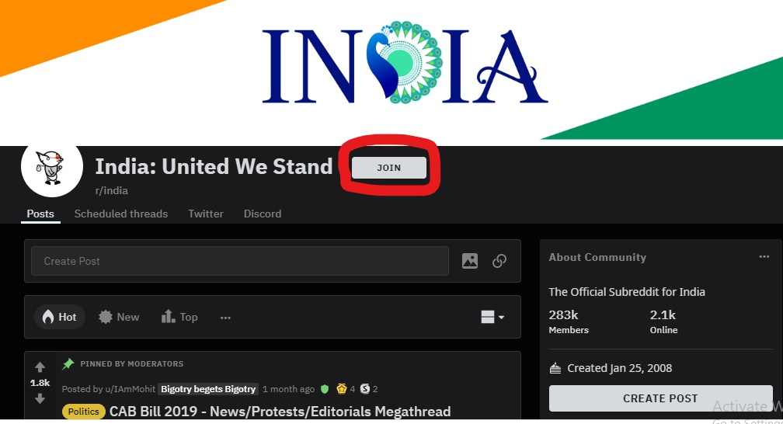
FOLLOWING SUBREDDITS

Slide 11
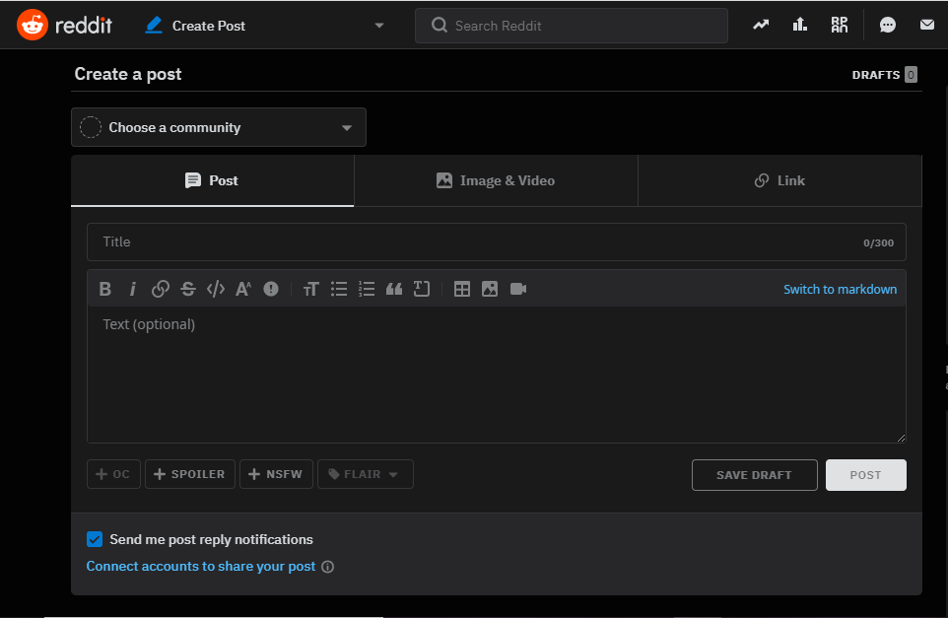
POSTING

Slide 12
KARMA AND COIN SYSTEM
Users can earn "karma" for their posts and comments, which reflects the user's standing within the community and their contributions to Reddit.
Users may also be gifted coins if another user particularly valued the comment or post, generally due to humorous or high-quality content (Reddit Premium feature).

Slide 13


